Slide 1

Tribhuvan University
Institute Of Engineering
Kathmandu Engineering College
Kalimati, Kathmandu
Minor Project
Mid report Defense
On
INTELLIGENT MENTAL HEALTH MONITORING SYSTEM
Presented By:
Abhipsa Nepal - KAT080BCT006
Abisha Dhungel - KAT080BCT007
Anushesh Ghimire - KAT080BCT016
Ayush Gyawali - KAT080BCT023
Date: Asadh 15, 2083
1

Slide 2
CHAPTER 1: INTRODUCTION
ABSTRACT
1.1 Background
Mental health issues evolve gradually and are often detected late
Traditional assessments are episodic and reactive
Daily digital text (journals, reflections) is a rich but underutilized data source
AI enables continuous, non-intrusive mental state monitoring
1.1.1 Natural Language Processing
Branch of Artificial Intelligence (AI) that understands human language.
Converts unstructured text into meaningful information.
Performs text preprocessing (tokenization, stop-word removal, etc.).
Widely used in chatbots, translation, and sentiment analysis.
In our system, it processes users' journal entries for analysis.
2

Slide 3
CHAPTER 1: INTRODUCTION
ABSTRACT
1.1.2 Sentiment Analysis
Technique that identifies emotions from text.
Classifies text as positive, negative, or neutral.
Measures emotional intensity using sentiment scores.
Our system uses VADER, a lexicon- and rule-based sentiment analysis tool.
Generates positive, negative, neutral, and compound scores to assess users' emotional state.
3

Slide 4
CHAPTER 1: INTRODUCTION
ABSTRACT
1.2 Problem Statement
Existing systems fail to detect early-stage stress patterns
Journaling data is rarely analyzed intelligently
Lack of integrated platforms combining:
Emotional analysis
Trend visualization
Personalized guidance
4

Slide 5
CHAPTER 1: INTRODUCTION
ABSTRACT
1.3 Objectives
To develop an intelligent mental health monitoring system that analyzes user-generated textual data using Natural Language Processing (NLP) and Machine Learning (ML) techniques to detect stress levels and provide meaningful insights and recommendations.
5

Slide 6

CHAPTER 1: INTRODUCTION
ABSTRACT
1.4 Scope And Applications
1.4.1 Scope
Supports personal mental health monitoring through mood logging and journaling
Analyzes stress and emotional states using ML and NLP techniques
Provides chatbot-based interaction for self-reflection and awareness
Ensures user privacy and focuses on awareness, not medical treatment
6

Slide 7
CHAPTER 1: LITERATURE REVIEW
ABSTRACT
1.4 Scope And Applications
1.4.2 Applications
Personal Mental Health Tracking
Self-Reflection and Journaling
Mental Health Awareness
Student Support
7

Slide 8
CHAPTER 1: LITERATURE REVIEW
Author & Year | Approach | Key Contribution | Limitation
Saha et al. (2019) | ML on social media text | Detected stress using linguistic features | No personalized continuous monitoring
Lin et al. (2020) | Deep Learning | User-level stress detection from social media | High computational complexity; less interpretable
Shah et al. (2024) | Random Forest + Questionnaire | Mobile mental health assistant for stress assessment | Relies mainly on questionnaire-based input
8

Slide 9
CHAPTER 2: LITERATURE REVIEW
2.1 Existing Systems
Mood tracking applications : Daylio, Moodfit
Journaling Platforms: Journey,Reflecty
Chatbot-Based Systems: Wysa, Woebat
Wellbeing Platforms: Headspace,Calm
ABSTRACT
2.2 Limitations of Previous Systems
Manual mood tracking and rule based analytics.
Limited analytics and personalized feedback
Privacy concerns and dependence on consistent user engagement
Few systems only integrate NLP and ML together
9

Slide 10
CHAPTER 2: LITERATURE REVIEW
ABSTRACT
2.3 Solutions Provided by Our System
Integrates journaling, mood tracking, wellness and chatbot support
ML and NLP-based early stress detection
User-friendly, privacy-focused mental health awareness platform with
secure user data handling
Simple self-help platform promoting mental well-being (not a medical
diagnosis)
Provides analytical insights.
10

Slide 11
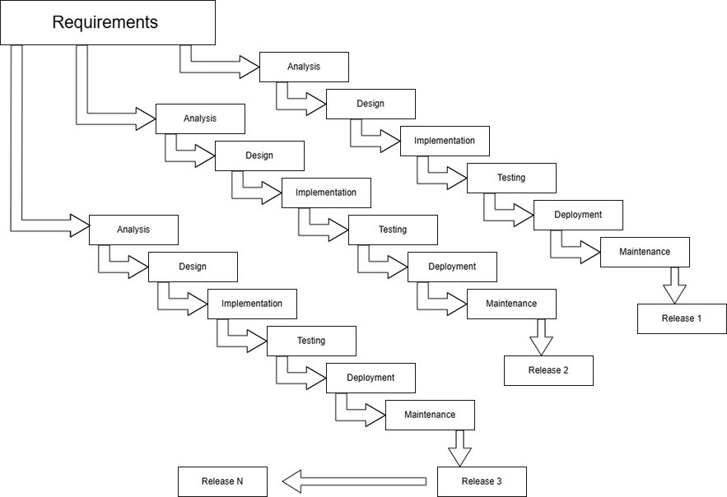
CHAPTER 3: METHODOLOGY
ABSTRACT
3.1 PROCESS MODEL
11
Figure 3.1 Incremental Process Model

Slide 12
CHAPTER 3: METHODOLOGY
ABSTRACT
3.1 PROCESS MODEL
Increment 1: User Registration and Journal Writing
Increment 2: Chatbot Design
Increment 3: Sentiment Analysis Implementation (Backend Development)
Increment 4: Database Integration and Score Management
Increment 5: Data Visualization and Mindfulness Suggestions
Final Integration and Deployment
12

Slide 13
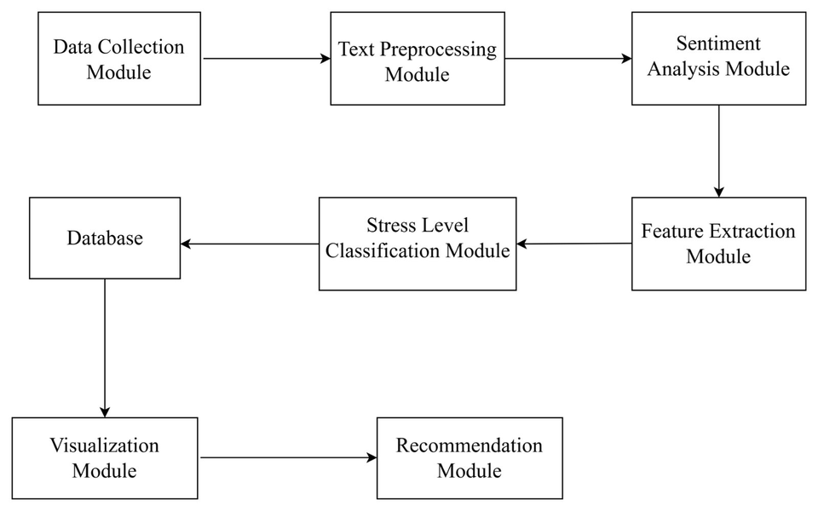
CHAPTER 3: METHODOLOGY
3.2 Block Diagram
ABSTRACT
Figure 3.2 Block Diagram of the System
13

Slide 14
CHAPTER 3: METHODOLOGY
3.3 Algorithm
ABSTRACT
STEP 1: Start the system and initialize the database connection.
STEP 2: Collect user input through chatbot or journal entry.
STEP 3: Preprocess the text: convert to lowercase, remove stop words, and eliminate special characters.
STEP 4: Apply VADER sentiment analysis to the preprocessed text to compute daily sentiment scores (positive, negative, neutral, compound).
STEP 5: Generate daily mood score from the sentiment scores.
STEP 6: Store the daily mood score and user data into database for future analysis.
STEP 7: Retrieve stored mood data and perform statistical feature extraction: compute weekly average, variance, and mood trends using rule-based statistical methods.
STEP 8: Classify stress level using Random Forest with the extracted features as input.
STEP 9: Display mood trends and stress levels using graphs and charts
STEP 10: Generate recommendations for mindfulness or professional support based on stress classification.
STEP 11: End the process
14

Slide 15
CHAPTER 3: METHODOLOGY
ABSTRACT
3.3 Algorithm
3.3.1 VADER (Valence Aware Dictionary and Sentiment Reasoner)
Lexicon and rule-based sentiment analysis technique designed for social and textual data
Assigns sentiment scores as positive, negative, neutral, and compound
Effectively captures emotional intensity, punctuation, capitalization, and negations
Well-suited for analyzing daily journal entries and reflections
Lightweight, fast, and does not require training data
15

Slide 16
CHAPTER 3: METHODOLOGY
ABSTRACT
3.3 Algorithm
3.3.2 Random Forest Algorithm
An ensemble machine learning algorithm based on multiple decision trees
Improves accuracy by combining predictions from many trees
Handles high-dimensional and non-linear data efficiently
Reduces overfitting compared to single decision tree models
Used to classify stress levels based on extracted sentiment and linguistic features.
16

Slide 17
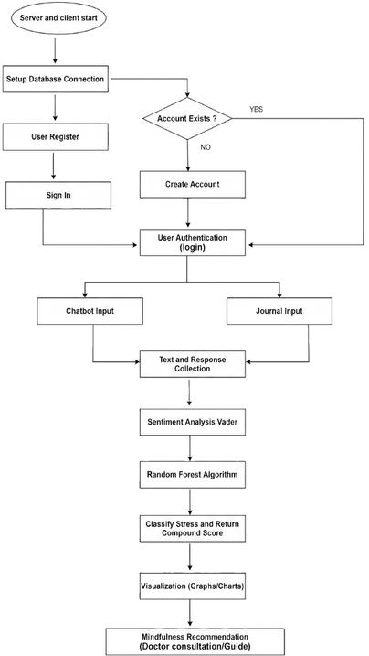
3.4 Flowchart
ABSTRACT
17
Figure 3.4 System Flowchart

Slide 18
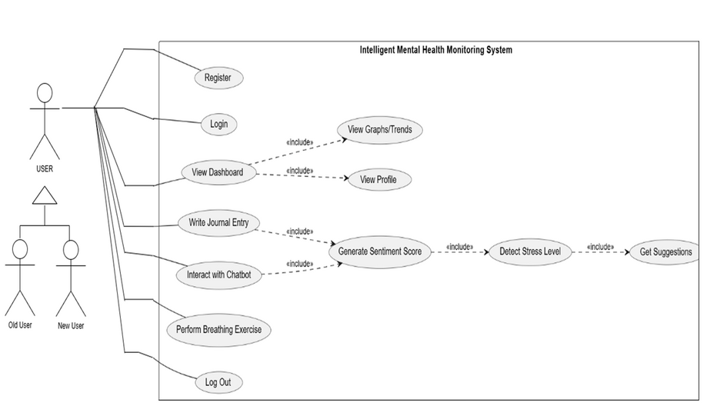
CHAPTER 3: METHODOLOGY
ABSTRACT
3.5 UML Diagram
3.5.1 Use Case Diagram
Figure 3.5.1 Use Case Diagram of Intelligent Mental Health Monitoring System
18

Slide 19
CHAPTER 3: METHODOLOGY
ABSTRACT
3.7 Tools Used
Frontend (HTML, CSS, JavaScript )
Backend (Python & Jupyter Notebook)
MongoDB & Pymongo
Flask Server
Numpy and Pandas
NLTK & VADER
Scikit-learn & TF-IDF Vectorizer
MongoDB & Pymongo
Jupyter Notebook
VS Code
Git & GitHub
19

Slide 20
3.7.1 APIS Used
Table 1: Backend APIS
ABSTRACT
Module | Method | Endpoint URL | Description / Scope
Authentication (routes/auth.py) | POST | /api/signup | Registers a profile, hashes password, generates tags.
 | POST | /api/login | Validates hashed credentials to authorize login session.
 | POST | /api/login_with_google | Single Sign-On federation check & profile match.
Journaling System (routes/journal.py) | POST | /api/journal/create | Extracts AI metrics, encrypts via Fernet, saves to database.
 | GET | /api/journal/<email> | Fetches entry history,decrypting fields dynamically in RAM.
Dashboard & Streaks (routes/dashboard.py) | GET | /api/dashboard/checkin/ status/<email> | Validates active date stamps to issue dynamic UI action gates.
 | POST | /api/dashboard/checkin/confirm | Commits completion logs and increments active daily streak.
User Settings (routes/settings.py) | GET | /api/settings/<email> | Fetches profile options, themes, and notification toggles.
 | PUT | /api/settings/update | Updates core profile configuration metadata fields.
 | PUT | /api/settings/change-password | Safely matches and updates user security password.
 | DELETE | /api/settings/delete | Cascading profile and encrypted record data purge.
20

Slide 21
CHAPTER 4: EPILOGUE
Successfully designed the login and sign up pages with proper connection to the database.
Added user profile, settings and designed a proper interactive dashboard.
Create journal,breathing, meditation pages and a proper help section including information about our project.
Developed backend logic for all successfully created pages.
Collected datasets and implemented text preprocessing techniques such as tokenization and cleaning of the datasets
Successfully integrated machine learning–based sentiment analysis to generate sentiment scores from user text inputs.
ABSTRACT
4.1 Tasks Completed
21

Slide 22
CHAPTER 4: EPILOGUE
4.2 ML Classification Model Performance Results
ABSTRACT
Table 2: Confusion Matrix
Actual \ Predicted | Pred: Low | Pred: Medium | Pred: High | Pred: Extreme
Actual: Low | 3023 | 83 | 72 | 65
Actual: Medium | 113 | 1038 | 107 | 53
Actual: High | 179 | 95 | 2246 | 559
Actual: Extreme | 321 | 220 | 743 | 1661
Table 3: Classification Report Metrics
Class Tier | Precision | Recall | F1-Score | Support (Samples)
Low | 0.83 | 0.93 | 0.88 | 3243
Medium | 0.72 | 0.79 | 0.76 | 1311
High | 0.71 | 0.73 | 0.72 | 3079
Extreme | 0.71 | 0.56 | 0.63 | 2945
22

Slide 23
CHAPTER 4: EPILOGUE
ABSTRACT
4.2 ML Classification Model Performance Results
Table 4: Summary Reports
Metric Scale | Precision | Recall | F1-Score | Total Support
Overall Accuracy | — | — | 0.75 | 10578
Macro Average | 0.74 | 0.75 | 0.75 | 10578
Weighted Average | 0.75 | 0.75 | 0.75 | 10578
23

Slide 24
4.3 Training Accuracy and report
Table 5: Classification Report on training dataset
Stress Level | Precision | Recall | F1-Score | Support
Extreme | 0.97 | 0.91 | 0.94 | 12,971
High | 0.99 | 0.94 | 0.96 | 12,971
Medium | 0.99 | 0.96 | 0.97 | 12,971
Low | 0.86 | 0.99 | 0.92 | 12,971
Training Set Performance Insights:
Medium Stress: Highest F1-Score (0.97) - Model excels at this class
High Stress: Excellent performance (0.96 F1) - Nearly 99% precision
Extreme Stress: Strong performance (0.94 F1) - 91% recall captures most cases
Low Stress: Good performance (0.92 F1) - Lowest precision (0.86) suggests some confusion with other classes
Overall accuracy: 94.82%

Slide 25
4.3 Tasks Remaining
Design of chatbot interface and its backend logic
Final integration of the system.
Backend logic for the charts and graphs section.

Slide 26
CHAPTER 4: EPILOGUE
ABSTRACT
4.4 Gantt Chart
Semester |  | 5th Semester |  |  |  |  | 6th Semester
Task | Dec | Jan | Feb | March | April | May | Jun | Jul | Aug
Documentation
Requirements Analysis
Design
Implementation
Test
Deployment
Maintenance
Release
24

Slide 27
REFERENCES
[1] K. Saha et al., “Stress Detection from Social Media Using Machine Learning,” ACM, 2019.
[2] H. Lin et al., “User-Level Psychological Stress Detection from Social Media,” Proceedings of KDD, 2020.
[3] I. Shah, N. Sheth, D. Shah, V. Sawant, and S. Patil, "Mental Health Assistant Using Machine-Learning," Educational Administration: Theory and Practice, vol. 30, no. 4, pp. 10775–10781, 2024, doi: 10.53555/kuey.v30i4.8346.
[4] Y. Zhang et al., “Stress Detection from Text Using Machine Learning Models,” IEEE Access, 2021.
[5] M. A. Khan et al., “Mental Stress Detection Using Machine Learning Techniques: A Review,” IEEE Access, 2022.
ABSTRACT
25

Slide 28
BIBLIOGRAPHY
Admin. (n.d.). Mental Health App Development Guide in 2026. KMS Technology. Retrieved January 24, 2026, from https://kms-technology.com/blog/the-complete-guide-to-mental-health-app-development-in-2026/
2. Jurafsky, & Martin. (n.d.). Speech and Language Processing (3rd ed.). Bird et al.
Kelta, Z. (2024, Aug 8). Classification in Machine Learning. Data Camp. https://www.datacamp.com/blog/classification-machine-learning
Admin. (2025, Aug 29). How Mental Health chatbot Handle stress. App Solutions. Retrieved 1 17, 2026, from https://theappsolutions.com/blog/development/mental-health-chatbots/
26

Slide 29
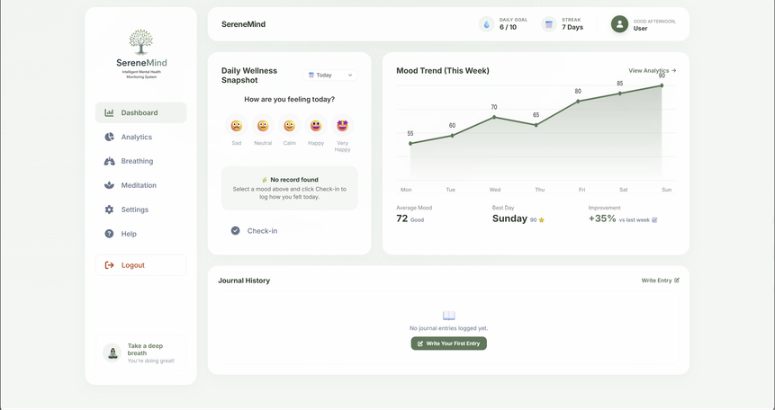
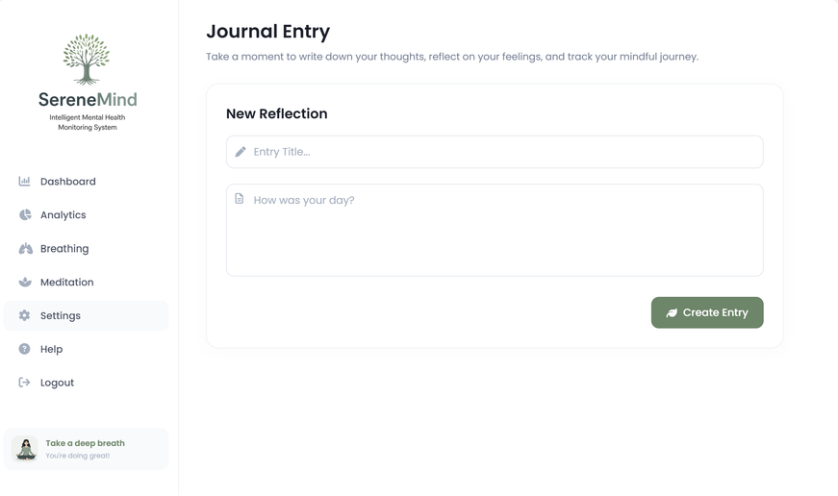
SCREENSHOTS
Figure: Dashboard
Figure: Journal page
27

Slide 30
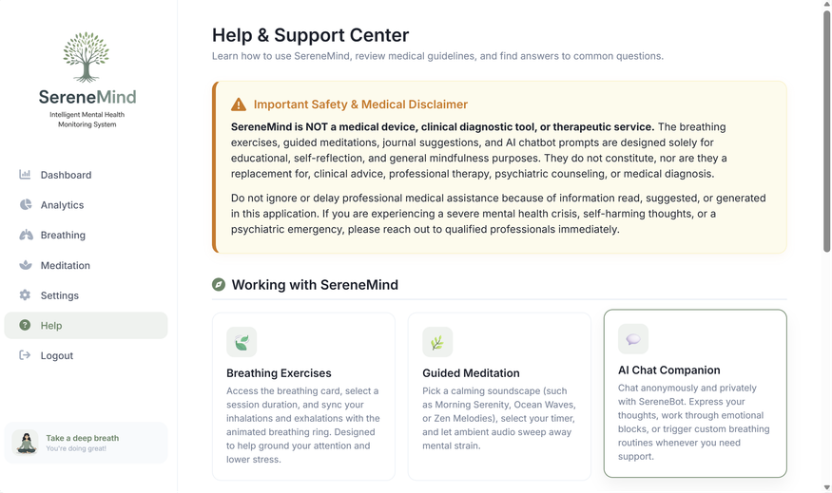
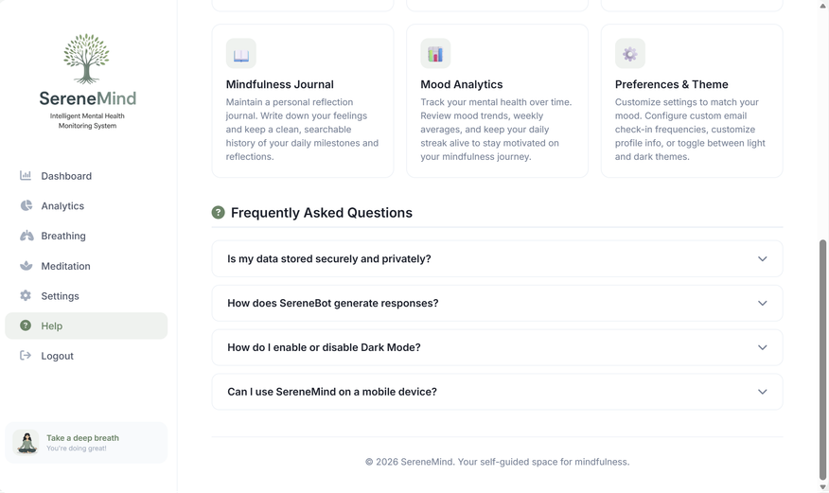
SCREENSHOTS
Figure: Help and support page
28

Slide 31
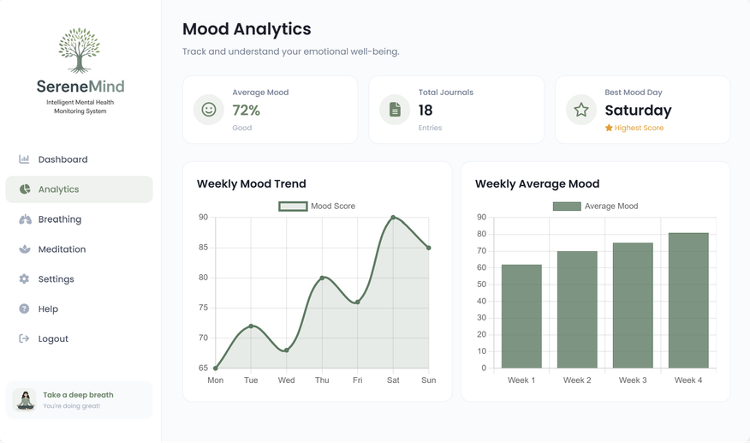
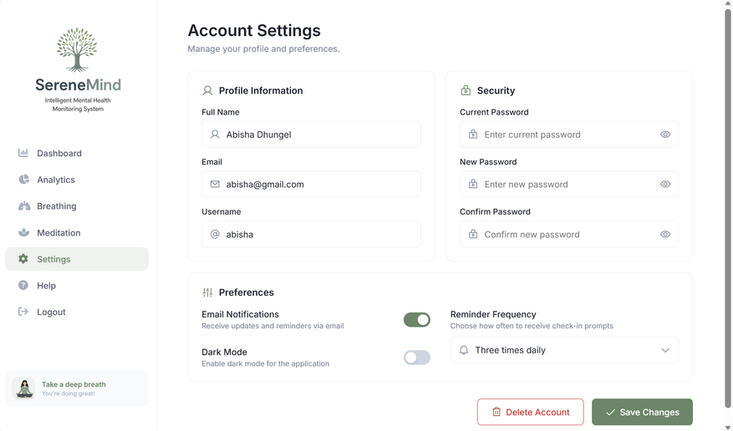
SCREENSHOTS
Figure: Analytics page
Figure: Settings page
29

Slide 32
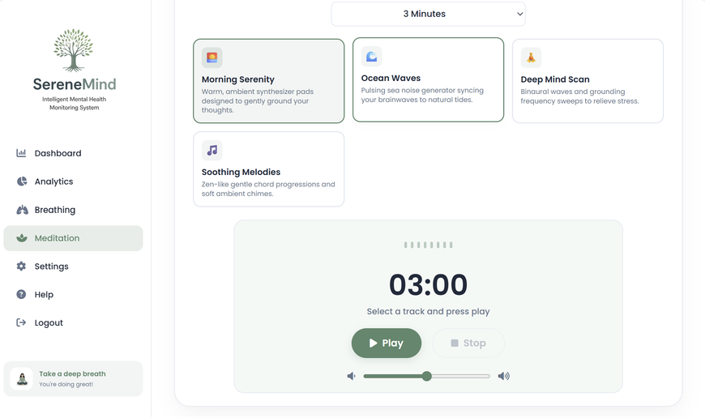
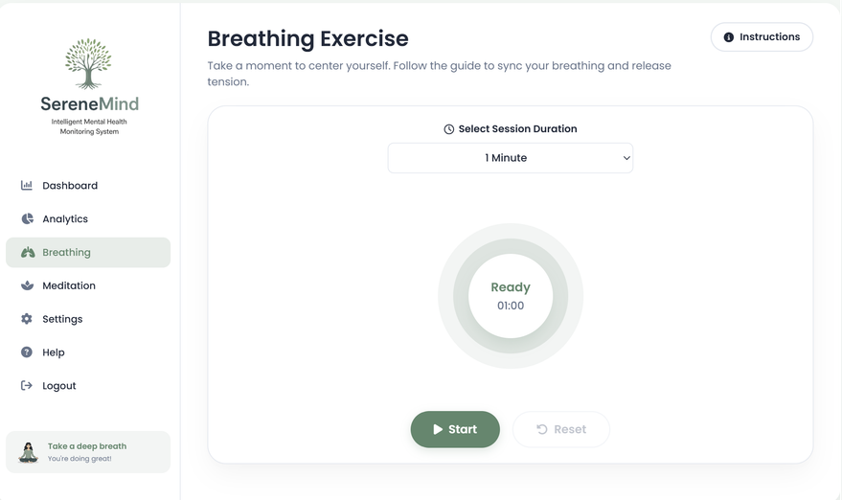
SCREENSHOTS
Figure: Meditation page
Figure: Breathing Exercise
30

Slide 33
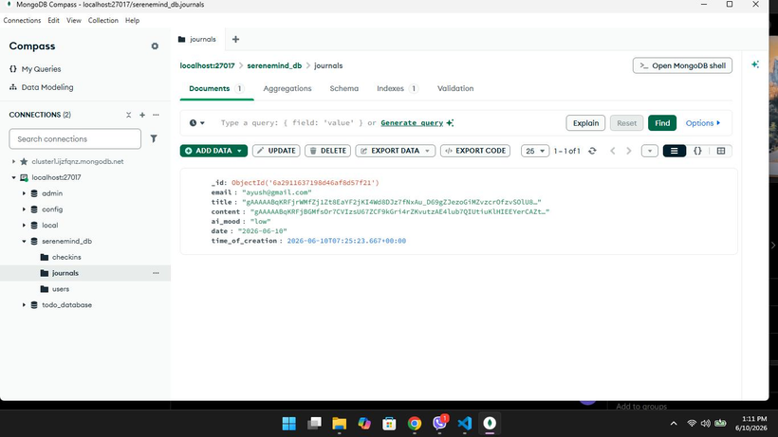
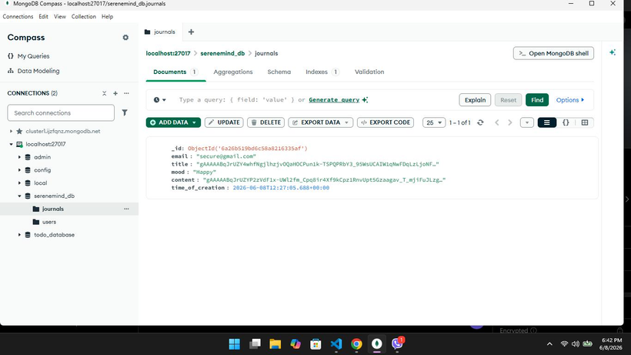
SCREENSHOTS
Figure: MongoDB Implementation
31

Slide 34

32

